Slide 1
Morphological Image Processing
Lecture 28-29, 16-Oct-12
Dr. Partha Pratim Das
Department of Computer Science and Engineering of
Indian Institute of Technology, Kharagpur
Notes:
Source: http://elearning.najah.edu/OldData/pdfs/Chapter9_Morphological_Image_Processing.ppt

Slide 2
Source: Chapter 09 of DIP, 3E: Morphological Image Processing
Preliminaries
Erosion and Dilation
Erosion
Dilation
Duality
Opening and Closing
The Hit-or-Miss Transformation
Some Basic Morphological Algorithms
Boundary Extraction
Hole Filling
Extraction of Connected Components
Convex Hull
Thinning
Thickening
Skeletons
Pruning
Morphological Reconstruction
Morphology of Binary Images
Not covered topics shown as this

Slide 3
Source: Chapter 09 of DIP, 3E: Morphological Image Processing
Grey-Scale Morphology
Erosion and Dilation
Opening and Closing
Some Basic Grey-Scale Morphology Algorithms
Grey-Scale Morphological Reconstruction
Not covered topics shown as this

Slide 4
Mathematic Morphology
used to extract image components that are useful in the representation and description of region shape, such as
boundaries extraction
skeletons
convex hull
morphological filtering
thinning
pruning

Slide 5
Mathematic Morphology
mathematical framework used for:
pre-processing
noise filtering, shape simplification, ...
enhancing object structure
skeletonization, convex hull...
Segmentation
watershed,…
quantitative description
area, perimeter, ...

Slide 6
Z² and Z³
set in mathematics, morphology represent objects in an image
binary image (0 = white, 1 = black) : the element of the set is the coordinates (x,y) of pixel belong to the object  Z²
gray-scaled image : the element of the set is the coordinates (x,y) of pixel belong to the object and the gray levels  Z³

Slide 7
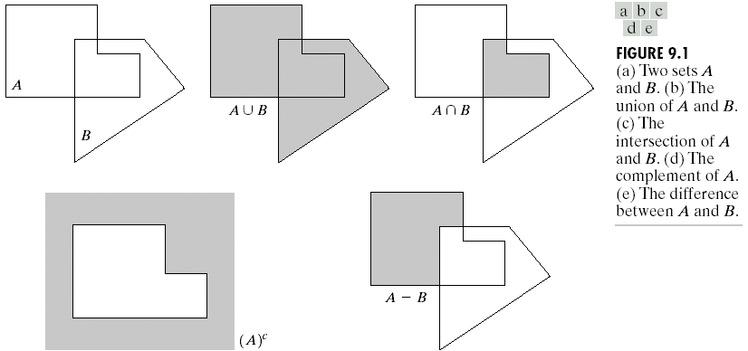
Basic Set Theory

Slide 8
Reflection and Translation

Slide 9
Logic Operations

Slide 10
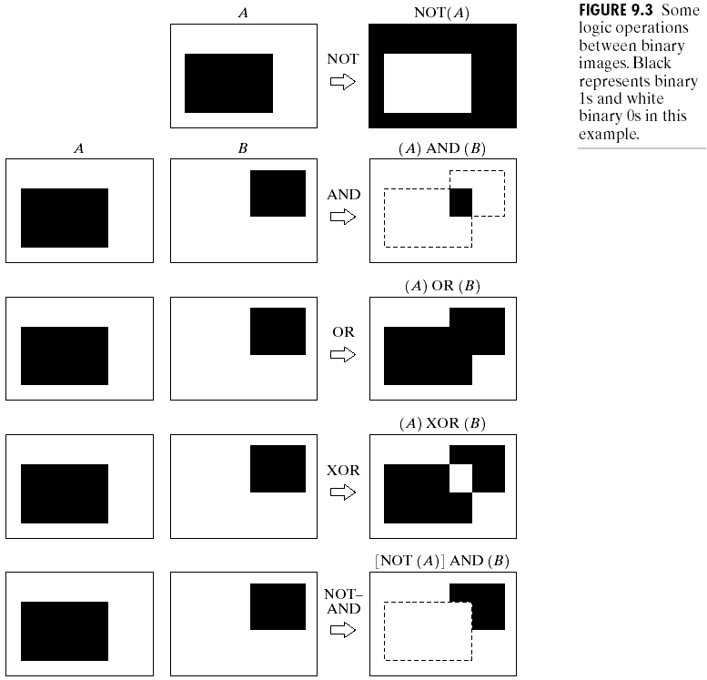
Example

Slide 11
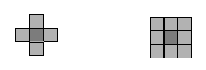
Structuring element (SE)
small set to probe the image under study
for each SE, define origo
shape and size must be adapted to geometric
properties for the objects

Slide 12
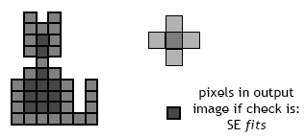
Basic idea
in parallel for each pixel in binary image:
check if SE is ”satisfied”
Fits
Hits
output pixel is set to 0 or 1

Slide 13


Basic morphological operations
Erosion
Dilation
combine to
Opening object
Closening background
keep general shape but smooth with respect to

Slide 14
Erosion
Does the structuring element fit the set?
erosion of a set A by structuring element B: all z in A such that B is in A when origin of B=z
shrink the object

Slide 15
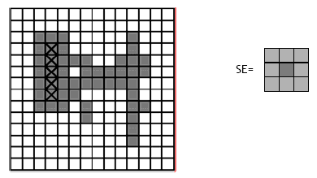
Erosion

Slide 16
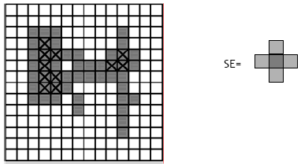
Erosion

Slide 17
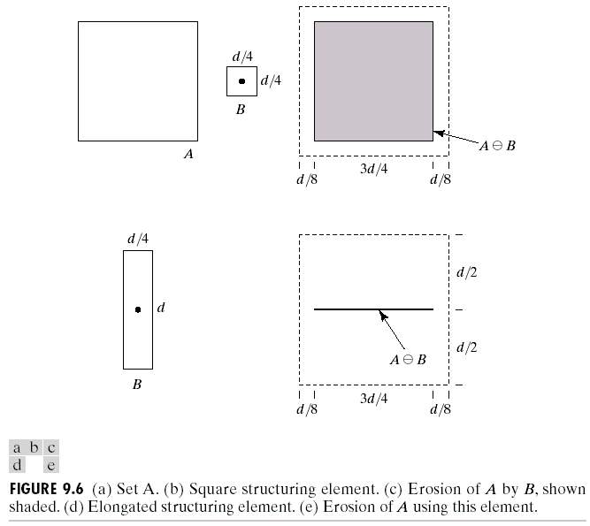
Erosion

Slide 18
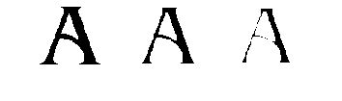
Erosion Example 1
Original image
Erosion by 3*3 square structuring element
Erosion by 5*5 square structuring element
Watch out: In these examples a 1 refers to a black pixel!

Slide 19

Erosion Example 2
Original image
After erosion with a disc of radius 10
Images taken from Gonzalez & Woods, Digital Image Processing (2002)
After erosion with a disc of radius 5
After erosion with a disc of radius 20

Slide 20
What Is Erosion For?
Erosion can split apart joined objects
Erosion can strip away extrusions
Watch out: Erosion shrinks objects

Slide 21
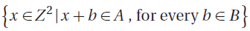
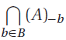
Problem
Prove that the following definitions of erosion are equivalent:

Slide 22
Dilation
Does the structuring element hit the set?
dilation of a set A by structuring element B: all z in A such that B hits A when origin of B=z
grow the object

Slide 23
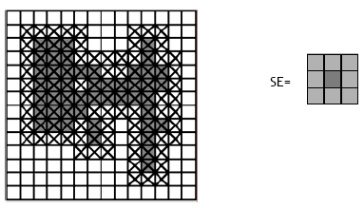
Dilation

Slide 24
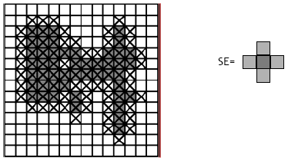
Dilation

Slide 25
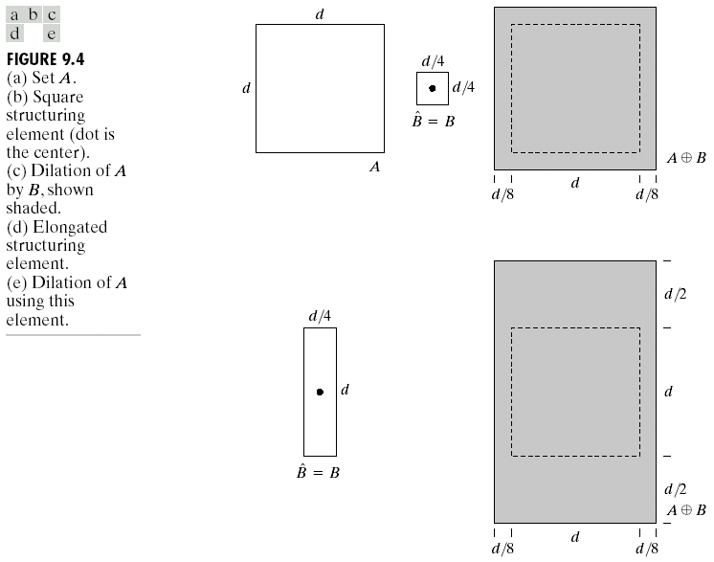
Dilation
B = structuring element

Slide 26

Dilation Example 1
Original image
Dilation by 3*3 square structuring element
Dilation by 5*5 square structuring element
Watch out: In these examples a 1 refers to a black pixel!

Slide 27
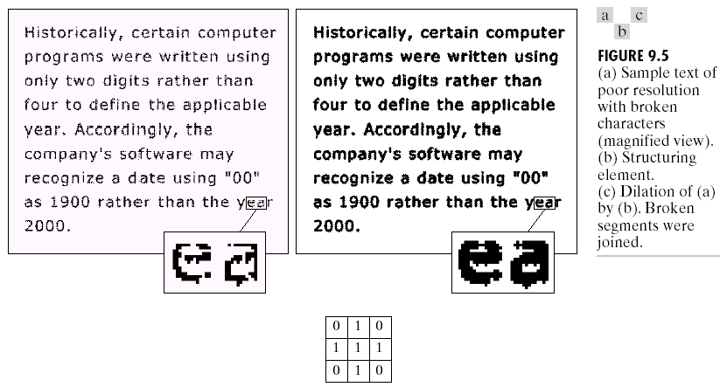
Dilation : Bridging gaps

Slide 28
What Is Dilation For?
Dilation can repair breaks
Dilation can repair intrusions
Watch out: Dilation enlarges objects

Slide 29
Useful
Erosion
removal of structures of certain shape and size, given by SE
Dilation
filling of holes of certain shape and size, given by SE

Slide 30
Duality
Erosion and Dilation are duals of each other with respect to set complementation and reflection
Prove.

Slide 31
Properties
Prove:
Dilation is commutative and associative
Erosion is neither commutative nor associative
Can you define identity structuring elements for dilation and erosion?

